Slide 1

Capstone Project: Econ – 6850 - 01
"Comparative Analysis of GDP Growth Determinants in the Midwest and the Northeast United States: An Empirical Study"
by Aman Dongre

Slide 2

Introduction
In this empirical paper I would like to discuss and investigate about how various factors such as Rent, Financial Institutions, Healthcare and Social Assistance, Real estate, Retail trade, and Manufacturing affect economic growth for a region.
Throughout the study we will observe how the different variables would affect the GDP growth rate differently in a region and the same set of variables in a different region of the U.S.
Through an empirical analysis, we examine what variables are more contributing to the GDP growth rate than the others.

Slide 3

The Midwest and the Northeast :
The states included in the Midwest are :
Missouri, Illinois, Ohio and Wisconsin The states included in the Northeast are : New York, Pennsylvania, New Jersey and Massachussets.
These states are among the largest states in these regions and would be sufficient to run an analysis.

Slide 4

Literature Review
https://jmparman.people.wm.edu/research-files/long-run-analysis-of-regional-inequalities-OREP-2021.pdf - discusses the Long-run analysis of regional inequalities in the U.S. by Trevon Logan, Bradley Hardy, and John Parman It discusses about how the development of a national and fully integrated economy have accelerated and decelerated over time, and these features are driven by unique sets of historical circumstances and policy choices.
Both studies discuss about the factors that affect the GDP and compare the development of different regions in the US although the factors that affect the GDP are different in the studies.
The study discusses about how historical and contemporary policies have contributed to regional economic disparities, providing insights for policymakers to address these challenges.

Slide 5
Data Sources for Research Paper :
For the Research Paper, I had obtained data from these sources shown below –
The data is obtained from the Federal Reserve Economic Data (FRED) economic data | St. Louis FED.
(https://fred.stlouisfed.org/)
For GDP growth rate and other variables –
https://fred.stlouisfed.org/series/USAGDPRQPSMEI

Slide 6
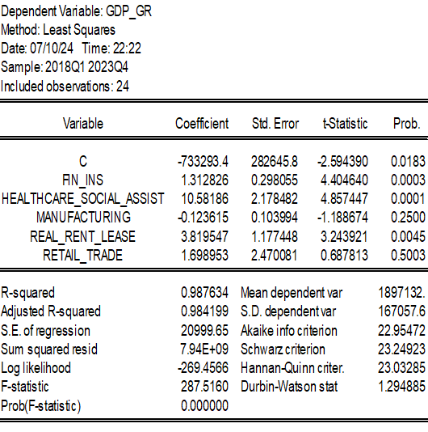
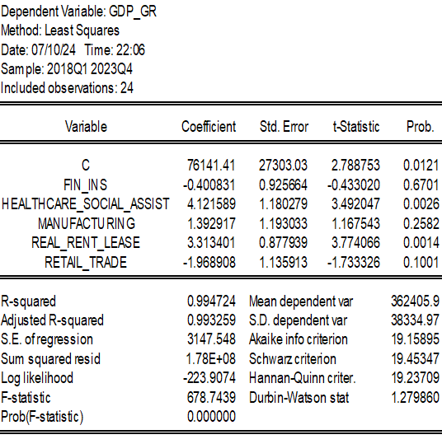
Model Specification
For this model, the estimated equation
would be which can be used in Eviews for both the regions is -
GDP growth rate = B0 + B1*Real_rent_lease + B2*Fin_ins+ B3*Retail trade+ B4*healthcare_social asiss + manufacturing+ u.
Using 5% significance level
The output tables for both the region are –
Sample from 2018q1 – 2023q4
Midwest :
Northeast :

Slide 7
Testing for Heteroskedasticity to describe the unequal spread:
Both the region models suffered from heteroskedasticity according to the Breusch-Pagan-Godfrey heteroskedasticity test and was adjusted accordingly with the Huber-White Hinkley Test.

Slide 8
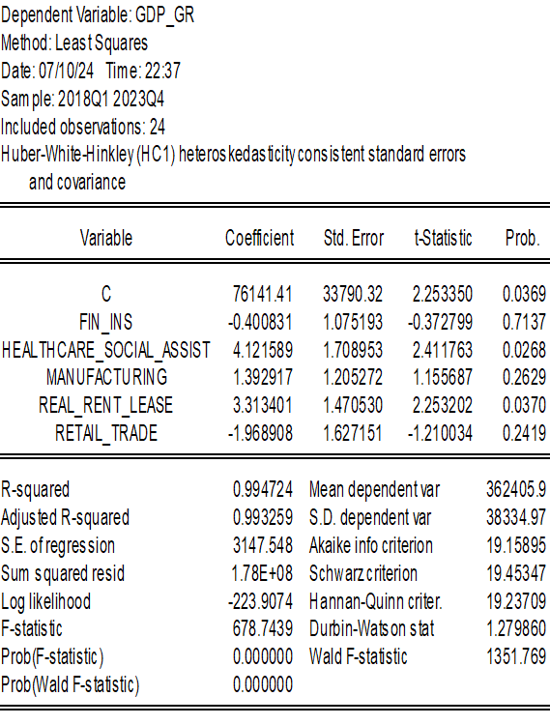
Model with Significant Variables after adjusting for Heteroskedasticity for Midwest :

Slide 9
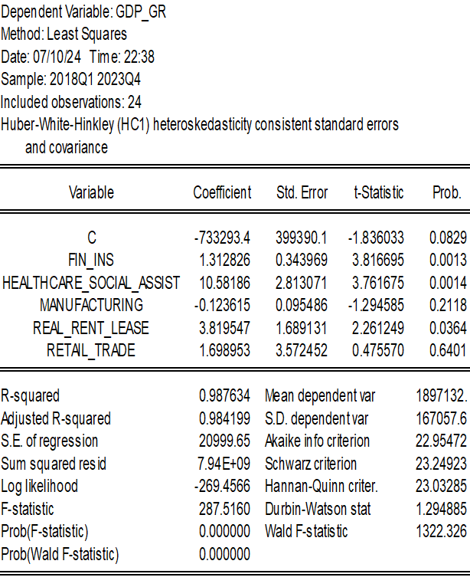
Model with Significant Variables after adjusting for Heteroskedasticity for Northeast region:

Slide 10
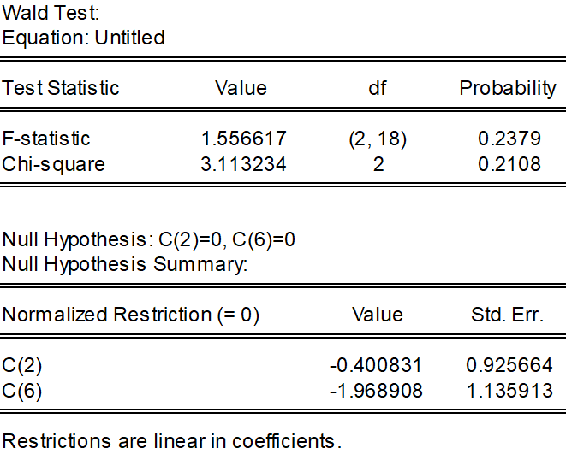
Wald Test to confirm the significance
By Wald test, both the sectors in Midwest, the finance and insurance and retail trade are also jointly insignificant to GDP growth rate different and vast and not related to each other and their significance is not that much as to the housing, rent and real estate sector.

Slide 11
Retail Trade in Northeast :
Since the p-value of the retail trade variable was 0.5, I ran a Wald test of the retail trade on the dependent variable to check the significance of the variable in the Northeast region.

Slide 12
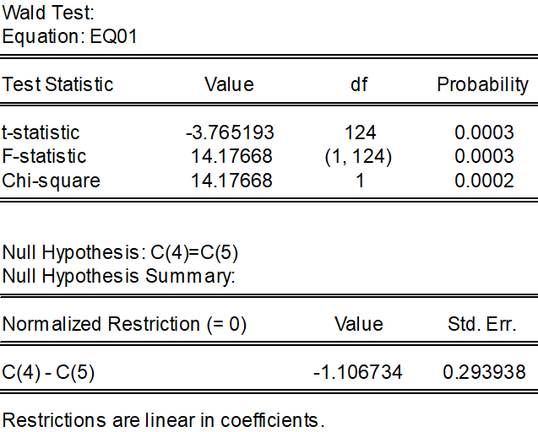
Hypotheses Testing
The Null Hypothesis will be H0 – The retail trade variable affects the dependent variable significantly.
Alternative hypothesis H1 – The variable does not affect the GDP growth rate significantly.
The p-value being less than alpha, the null hypothesis can be rejected and said that the retail trade variable does not affect the GDP growth rate significantly in Northeast.

Slide 13
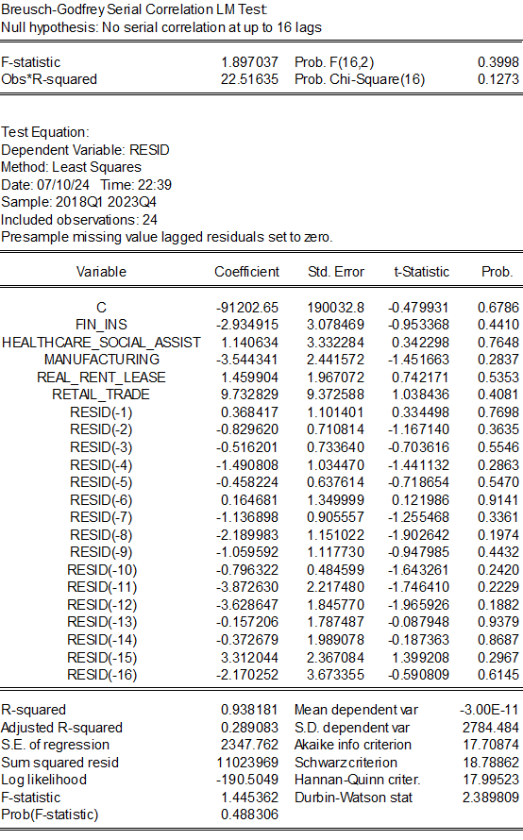
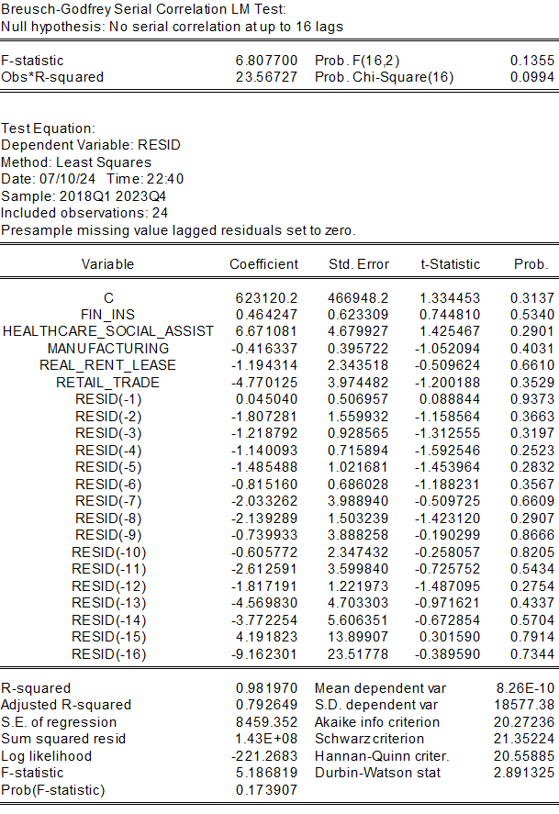
Testing for Serial Correlation :
Northeast:
Midwest:
As all the p-values for the model are above 0.05. There is no serial correlation in both the models for both the regions.

Slide 14
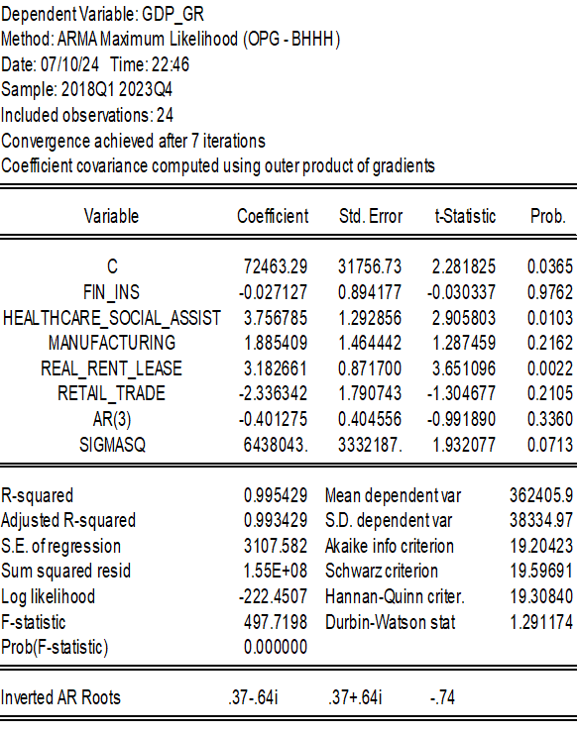
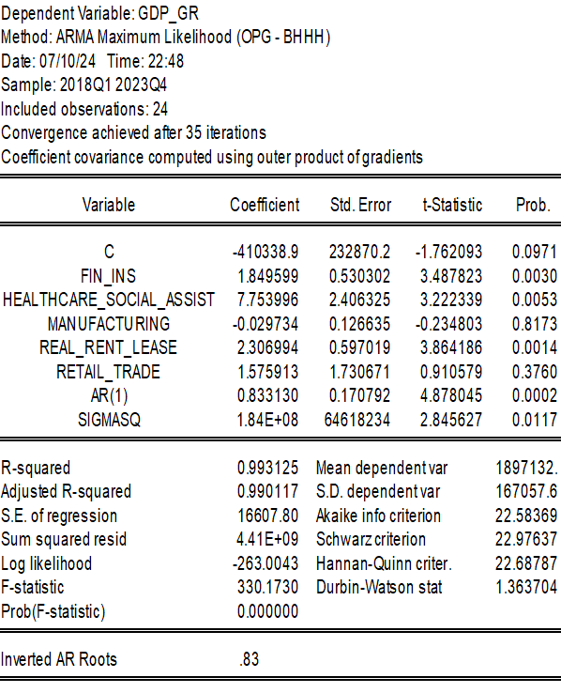
Addition of AR terms:
Midwest:
Northeast:

Slide 15

Retail Trade for Northeast and Manufacturing for Midwest :
The addition of AR terms made the retail trade variable more significant that it was in the Northeast region.
Simultaneously, The manufacturing variable became more significant for the Midwest than it was before the addition of the AR terms.
Also, the r-squared value increases.

Slide 16
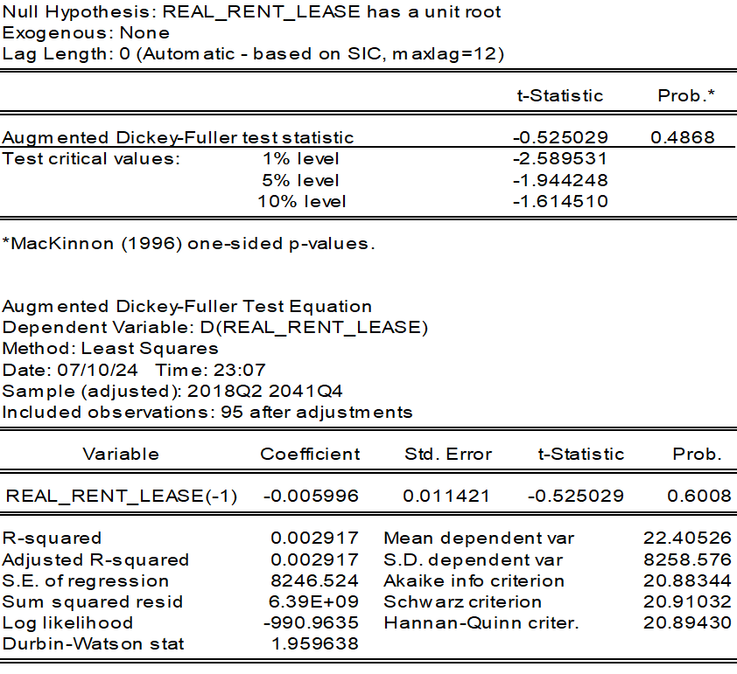
Unit Root Test for the Midwest region to check the stationarity:
As the real estate, rent and lease variable affects the GDP growth rate the most in Midwest, I tried the unit root test on this sector.
The variable does not contain a unit root according to p-value.

Slide 17

Results
In our study all the variables which affected the region were significant such as the real assets, rental and lease variable for Midwest was the most contributing sector for the Midwest region whereas for the Northeast it was Finance and insurance and healthcare sectors.
The model explains how the sectors affect the different regions in the U.S. and what sectors contribute more on a particular region in the U.S. This helps the analysts and policy makers to take steps and focus more on what factors are the regions affected by the most and steps to improve other sectors efficiently as well.
Different actions can also be taken as to promote other sectors as well such as steps to improve the Financial sector in the Midwest, One example could be, If STL’s living conditions can be improved, more people will come in the city instead of moving out of the city and it can be as popular as it was in the past and once a financial hub as well.

Slide 18

Conclusion
To improve the economy by focusing on different sectors in specific regions, targeted strategies can increase the unique strengths of each area. In the Midwest, enhancing the real estate sector through affordable housing projects, commercial infrastructure development, and regulatory support can stimulate construction, attract businesses, and create jobs, driving GDP growth. Additionally, investing in agricultural and manufacturing advancements, improving supply chain logistics, and providing workforce training can boost productivity and competitiveness.
While for the Northeast, focusing on the financial sector, through regulatory enhancements and fostering financial innovation, can attract investment and enhance economic stability, contributing significantly to GDP growth.

Slide 19
Thank You!

